Slide 1
MBB 243 - Lecture 10
Ryan Morin

Slide 2
Learning goals for the week
More plotting with ggplot and add-on packages
Become more acquainted with gene expression data and methods for visualizing genomic data
Perform parametric (Pearson) and non-parametric (Spearman) correlation in R
Apply some basic methods for statistical tests with categorical and continuous variables

Slide 3
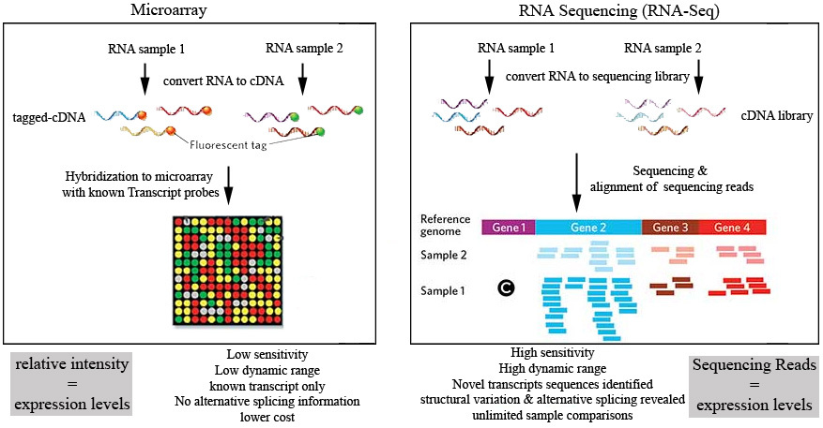
RNA-seq vs Arrays

Slide 4
How comparable are they?
Originally, comprehensive gene expression measurements could only be accomplished by hybridizing cDNA to arrays and quantifying fluorescence (an analog approach)
Only possible to measure the abundance of genes with complementary probes on the array
RNA-seq has become widely popular as an alternative quantification approach and it has several theoretical advantages
Able to quantify newly identified genes/transcripts
Measure abundance of alternative isoforms
Higher dynamic range of measurements

Slide 5
Dynamic range?
The ratio between the largest and smallest possible values of a quantity (or measurements)
Digital techniques can theoretically measure values as low as zero although the meaning of zero depends on context
Actual limits of RNA-seq depends on how much sequencing data was produced (sampling)
Dynamic range of microarrays is relatively fixed due to the analog nature
No distinction in measurements of true zero vs values near zero

Slide 6
Data sets
head(array[,c(1:3)],4)
## # A tibble: 4 x 3 ## Gene M1_LS1 D_LS21 ## <chr> <dbl> <dbl> ## 1 A1CF 9.47 9.79 ## 2 A2M 10.8 9.76 ## 3 A4GALT 2.16 2.16 ## 4 A4GNT 2.16 2.16
head(rnaseq[,c(1:3)],4)
## # A tibble: 4 x 3 ## Gene M1_LS1 D_LS21 ## <chr> <dbl> <dbl> ## 1 MARC1 2.44 2.62 ## 2 MARCH1 0.669 2.17 ## 3 MARC2 3.40 3.28 ## 4 MARCH2 4.94 5.48

Slide 7
Convenient long format version
head(array_long,4)
## # A tibble: 4 x 3 ## Gene Tumour Expr ## <chr> <chr> <dbl> ## 1 A1CF M1_LS1 9.47 ## 2 A1CF D_LS21 9.79 ## 3 A1CF A_MK11 9.61 ## 4 A1CF A_MK12 10.6
head(rnaseq_long,4)
## # A tibble: 4 x 3 ## Gene Tumour Expr ## <chr> <chr> <dbl> ## 1 MARC1 M1_LS1 2.44 ## 2 MARC1 D_LS21 2.62 ## 3 MARC1 A_MK11 1.23 ## 4 MARC1 A_MK12 3.13

Slide 8
Aside: Excel thinks these are dates
group_by(array_long,Gene) %>% filter(Gene %in% c("SEPT9","MARCH1")) %>% slice_head()
## # A tibble: 2 x 3 ## # Groups: Gene [2] ## Gene Tumour Expr ## <chr> <chr> <dbl> ## 1 MARCH1 M1_LS1 6.36 ## 2 SEPT9 M1_LS1 6.66

Slide 9

Easy fix, right?

Slide 10
Signal range: RNA-seq vs Arrays
Measurements for genes in the same sample
Where does the trend become less linear?
Which technology appears to have better resolution among points near the bottom of either scale?
How similar are the measurements as a whole?
compare_meth = left_join(array,rnaseq,by="Gene",suffix=c(".array",".rnaseq")) %>% filter(!is.na(M1_LS1.rnaseq)) ggplot(compare_meth,aes(x=M1_LS1.rnaseq,M1_LS1.array)) + geom_point(alpha=0.2) + geom_smooth() + theme_cowplot()

Slide 11
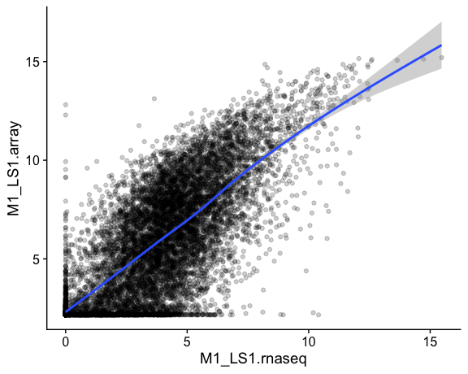

Slide 12
Correlation
When one variable changes in magnitude, another changes in magnitude
Positive correlation (one increases, the other increases)
Negative correlation (one increases, the other decreases)
Correlation coefficients are a statistical measure of the strength and sign (+/-) of a linear relationship
Measured by Pearson (parametric) or Spearman (non-parametric)
Pearson doesn’t work for non-linear relationships whereas Spearman does not require a specific relationship

Slide 13
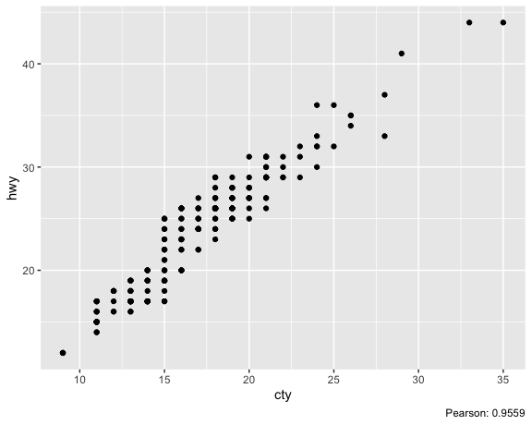
Positive correlation

Slide 14
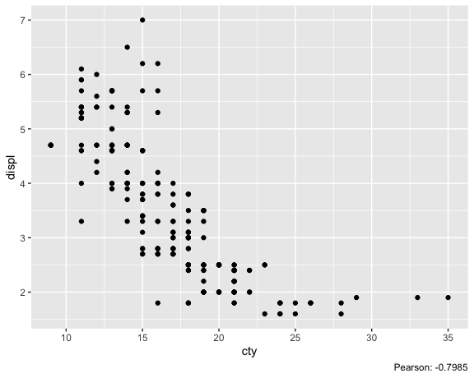
Negative correlation

Slide 15
Quick and dirty correlation
The base R cor function is tried, tested and true for calculation the correlation between two variables
Various packages exist for looking at possible correlations across multiple variables in a tidy data frame
There is a ggcorr and a ggcor, for some reason
#drop year because there are only two values ggcorr(mpg%>% select(-year))

Slide 16
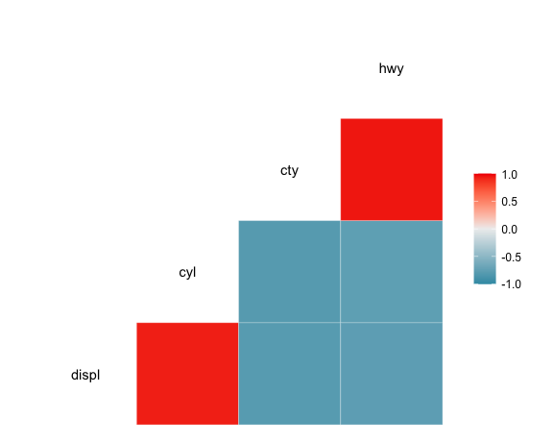

Slide 17
More flexible: ggcor’s Quickcor
quickcor(mpg[,c("displ","cyl","cty","hwy")],type="upper") + geom_colour()

Slide 18
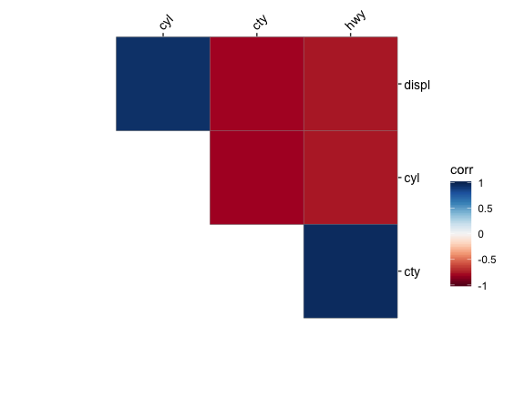

Slide 19
Quickcor
#[, 1] mpg Miles/(US) gallon #[, 2] cyl Number of cylinders #[, 3] disp Displacement (cu.in.) #[, 4] hp Gross horsepower #[, 5] drat Rear axle ratio #[, 6] wt Weight (1000 lbs) #[, 7] qsec 1/4 mile time #[, 8] vs Engine (0 = V-shaped, 1 = straight) #[, 9] am Transmission (0 = automatic, 1 = manual) #[,10] gear Number of forward gears #[,11] carb Number of carburetors quickcor(mtcars, type = "upper") + geom_circle2()

Slide 20
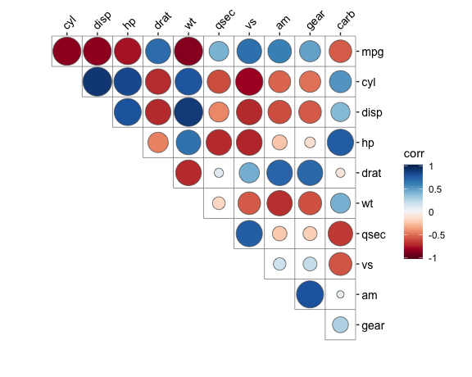

Slide 21
More Quickcor
We can embed the actual correlation coefficients along with the coloured representations
Note the cor.test option is used here (to be revisited)
quickcor(mtcars, cor.test = TRUE) + geom_square(data = get_data(type = "lower", show.diag = FALSE)) + geom_mark(data = get_data(type = "upper", show.diag = FALSE), size = 2.5) + geom_abline(slope = -1, intercept = 12)

Slide 22
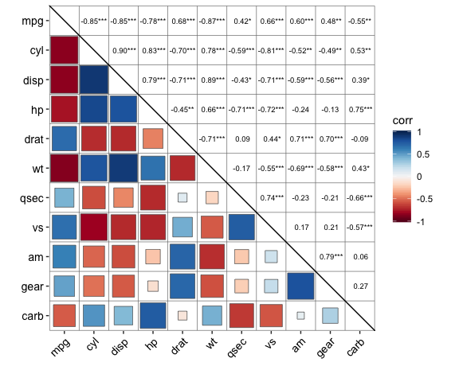

Slide 23
Correlations aren’t always meaningful
Some seemingly strong correlations in the mtcars example are between a categorical and a numeric variable
e.g. v-shaped engine vs the number of cylinders
These may still be meaningful but imagine if you compared two variables that are supposed to be continuous and one (or both) is instead behaving like a categorical variable due to low variability
ggplot(mtcars,aes(x=vs,y=cyl)) + geom_point()

Slide 24
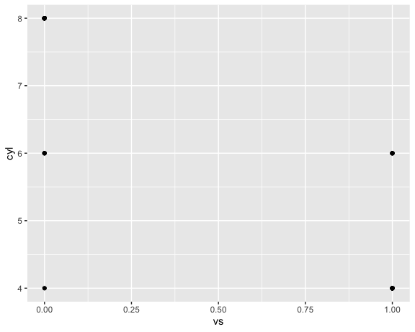

Slide 25
Associations between other types of variables
We often want to know if a categorical variable is associated with another categorical variable
e.g. Do the values of two categorical variables occur together more/less than we expect by chance?
For this scenario, the appropriate test depends on the number of categories we have. Fisher’s test is used for a 2x2 table such as this example
e.g. does the frequency of metastasis in this cancer vary by subtype?
ggplot(metadata, aes(x = Subtype, y = Metastasis)) + geom_count()

Slide 26
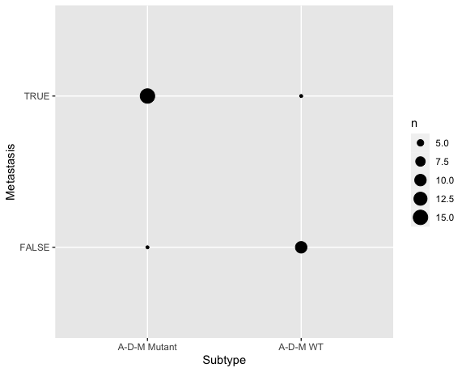

Slide 27
Another plotting option: geom_mosaic
ggplot(metadata) + geom_mosaic(aes(x = product(Metastasis, Subtype), fill = Metastasis))

Slide 28
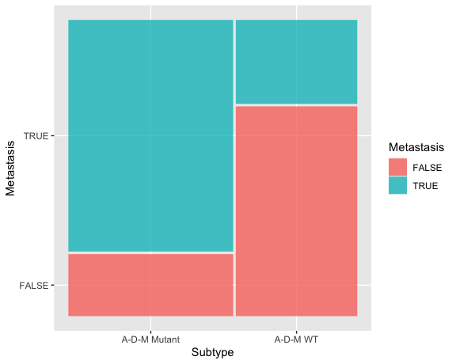

Slide 29
Testing the hypothesis
table(meta$Subtype,meta$Metastasis)
## ## FALSE TRUE ## A-D-M Mutant 4 15 ## A-D-M WT 10 4
fisher.test(table(meta$Subtype,meta$Metastasis))
## ## Fisher's Exact Test for Count Data ## ## data: table(meta$Subtype, meta$Metastasis) ## p-value = 0.005667 ## alternative hypothesis: true odds ratio is not equal to 1 ## 95 percent confidence interval: ## 0.01584779 0.65722230 ## sample estimates: ## odds ratio ## 0.1160044

Slide 30
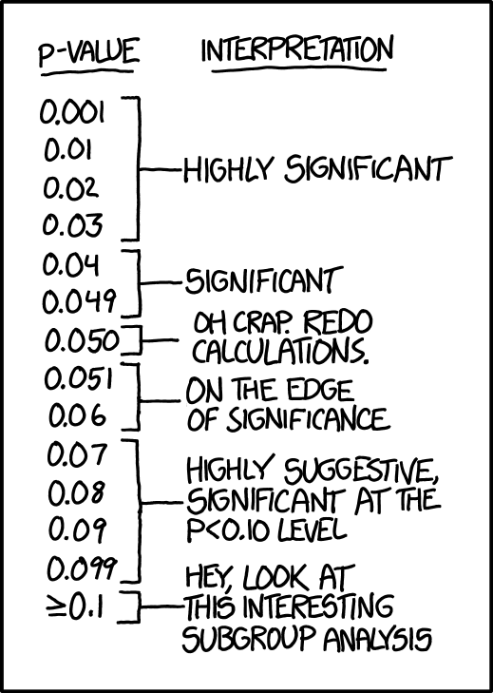
How NOT to interpret P values
P value < 0.05 is a standard threshold
Beyond this, P values have little meaning in isolation
Sometimes ordering (e.g ranking) on P values is useful when many tests were done
In the lab we will cover how to properly deal with P values when testing many hypotheses

Slide 31
Correlation across platforms
Lets see how correlated the expression is for one gene across all the samples in the two technologies
i.e. all RNA-seq vs all array measurements for ACTB
actb <- data.frame( tumour = rnaseq_wide$Tumour, rnaseq = rnaseq_wide$ACTB, array = array_wide$ACTB ) actb
## tumour rnaseq array ## 1 M1_LS1 10.863079 13.54694 ## 2 D_LS21 10.734464 13.53852 ## 3 A_MK11 10.908948 13.59755 ## 4 A_MK12 11.112153 13.60776 ## 5 D_MK18 10.419613 13.39121 ## 6 D_MK26 10.913151 13.77605 ## 7 D_MK34 10.605868 13.48886 ## 8 D_MK42 10.347477 13.11754 ## 9 A_MK47 10.710634 13.53016 ## 10 A_MK4 9.838132 12.66875 ## 11 D_MK51 10.857717 13.98401 ## 12 D_MK9 10.465250 13.48584 ## 13 DM1_MK44 10.963416 13.49755 ## 14 DM1_MK45 11.010451 13.49276 ## 15 DM1_MK52 10.723823 13.45507 ## 16 AM1_MK53 10.966340 13.72380 ## 17 DM1_LS7 10.681203 13.58296 ## 18 DM1_MK17 10.202552 13.14814 ## 19 AM1_MK36 10.299265 13.11344 ## 20 WT_MK50 11.736406 14.10897 ## 21 WT_MK8 10.023311 13.52137 ## 22 WT_LS27 10.539837 13.56717 ## 23 WT_LS35 11.277799 14.21736 ## 24 WT_LS39 11.212624 13.88118 ## 25 WT_LS65 10.525257 13.36262 ## 26 WT_MK13 11.471274 13.90485 ## 27 WT_MK15 10.004529 13.76013 ## 28 WT_MK16 10.569030 13.22569 ## 29 WT_MK19 10.663015 13.86606 ## 30 WT_MK21 10.911227 13.94303 ## 31 WT_MK27 9.648160 14.07058 ## 32 WT_MK39 10.884277 13.46193 ## 33 WT_MK49 12.058161 14.48893
ggplot(actb, aes(y = rnaseq, x = array)) + geom_point() + labs(title = "ACTB expression")+ geom_smooth(method="lm") + theme_cowplot()

Slide 32
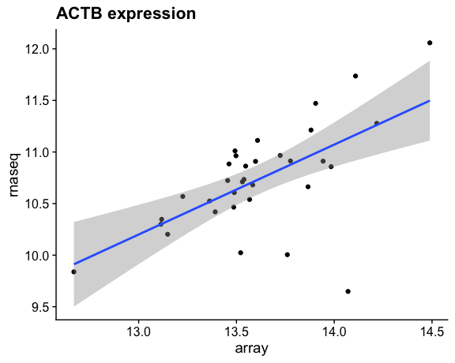

Slide 33
What is the correlation coefficient?
Note both Pearson and Spearman give positive correlation coefficients
Where are the outliers and can we improve our data based on this information?
cor(actb$rnaseq, actb$array, method = "pearson")
## [1] 0.6157824
cor(actb$rnaseq, actb$array, method = "spearman")
## [1] 0.5882353

Slide 34
Same comparison without outliers
actb_nolow <- filter(actb, rnaseq >= 10.25) cor(actb_nolow$rnaseq, actb_nolow$array, method = "pearson")
## [1] 0.8403645
cor(actb_nolow$rnaseq, actb_nolow$array, method = "spearman")
## [1] 0.7679256
ggplot(actb_nolow, aes(y = rnaseq, x = array)) + geom_point() + labs(title = "ACTB expression") + geom_smooth(method="lm") +theme_cowplot()

Slide 35
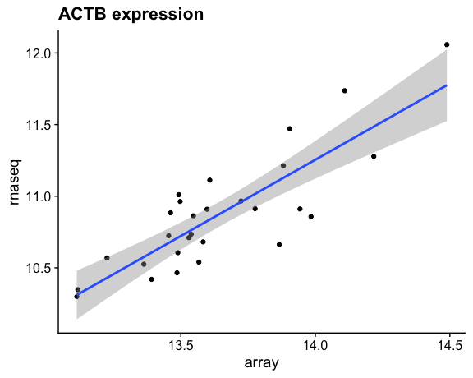

Slide 36
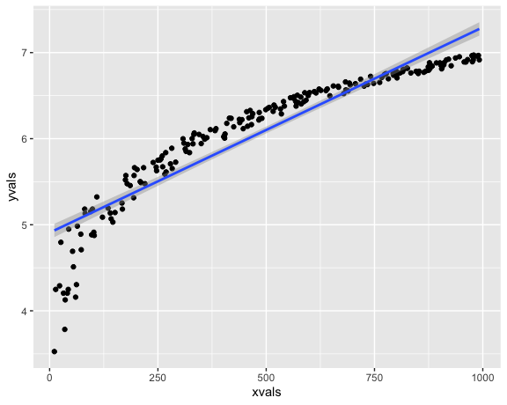
Is Spearman ever better?
Because it’s non-parametric, it can be useful when the relationship between your variables is non-linear
Spearman correlation is more fair to use if you believe the relationship is monotonic but not linear whereas Pearson is appropriate if you think there is a linear relationship

Slide 37
Better quantified by Spearman
cor(df$xvals,df$yvals,method="pearson")
## [1] 0.9257139
cor(df$xvals,df$yvals,method="spearman")
## [1] 0.9950423

Slide 38
How does it work?
A non-linear monotonic relationship can appear linear when ranks are used instead of the actual values
Spearman correlation involves converting continuous values to ranks based on the relative order of the values
df = arrange(df,xvals) df$xrank = c(1:length(df$xvals)) df = arrange(df,yvals) df$yrank = c(1:length(df$xvals)) # rank each variable individually head(df,4)
## xvals jitter yvals xrank yrank ## 1 11 23 3.526361 1 1 ## 2 35 9 3.784190 6 2 ## 3 36 26 4.127134 7 3 ## 4 60 4 4.158883 13 4
ggplot(df,aes(x=xrank,y=yrank)) + geom_point()

Slide 39
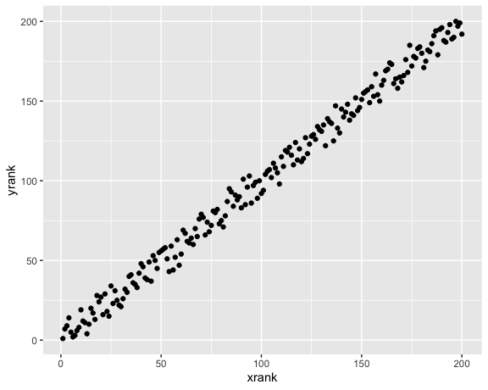

Slide 40
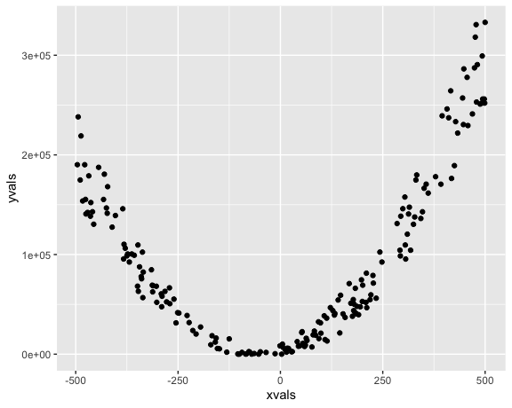
More extreme example

Slide 41
cor(df$xvals,df$yvals,method="pearson")
## [1] 0.3332257
cor(df$xvals,df$yvals,method="spearman")
## [1] 0.272296
# EPIC FAIL!

Slide 42
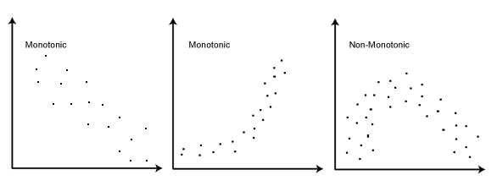
Correlation only works for monotonic relationships

Slide 43
Is a coefficient enough?
When is a correlation “good”?
coefficients are difficult to interpret in isolation
The same correlation coefficient can be obtained with different data distributions
cor_coef <- inner_join(rnaseq_long, array_long, by = c("Gene", "Tumour"), suffix = c("_R", "_A")) %>% group_by(Gene) %>% filter(sd(Expr_R) > 0, sd(Expr_A) > 0) %>% summarize(cor_coeff = cor(Expr_R, Expr_A, method = "pearson")) # Drop genes with low standard deviation cor_coef
## # A tibble: 10,872 x 2 ## Gene cor_coeff ## <chr> <dbl> ## 1 A1CF 0.975 ## 2 A2M 0.891 ## 3 A4GALT -0.300 ## 4 AAAS 0.568 ## 5 AACS 0.786 ## 6 AADAC 0.877 ## 7 AAGAB 0.657 ## 8 AAK1 0.461 ## 9 AAMP 0.436 ## 10 AARS 0.571 ## # … with 10,862 more rows

Slide 44
Is good/bad correlation enough?
bot_cor = cor_coef %>% arrange(cor_coeff) %>% head(1) %>% pull(Gene) top_cor = cor_coef %>% arrange(-cor_coeff) %>% head(1) %>% pull(Gene) # get the gene with the lowest and highest correlation coefficient
long_exp = inner_join(rnaseq_long, array_long, by = c("Gene", "Tumour")) filter(long_exp,Gene==bot_cor) %>% ggplot(aes(x=Expr.x,y=Expr.y)) + geom_point()

Slide 45
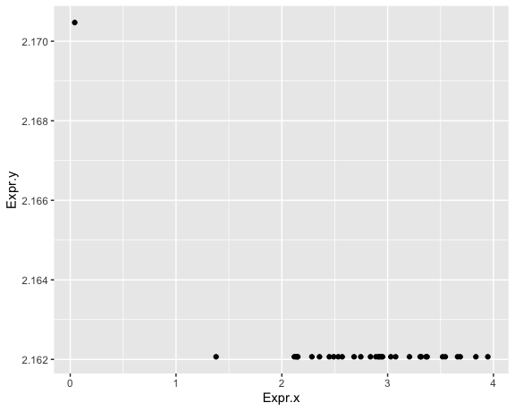

Slide 46
# plot to compare filter(long_exp,Gene==top_cor) %>% ggplot(aes(x=Expr.x,y=Expr.y)) + geom_point() + labs(title=paste(top_cor,": Best correlated gene"))

Slide 47
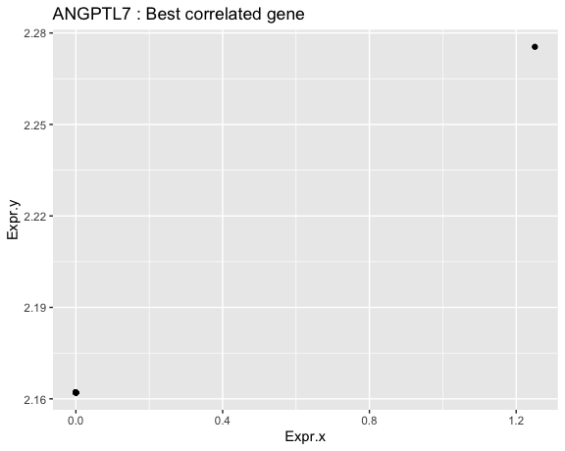

Slide 48
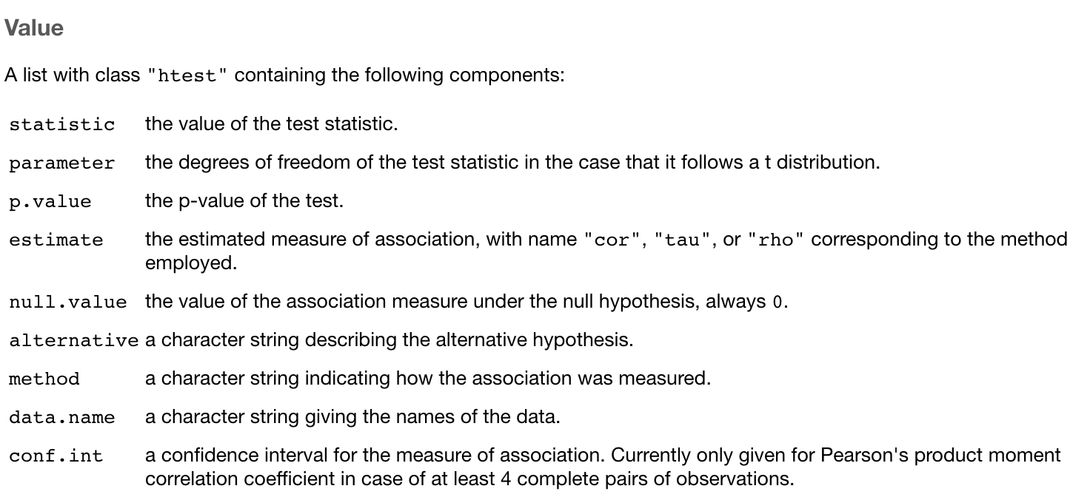
Testing for significant correlation

Slide 49
Testing for significant correlation
ACTB correlation is significant based on the small P value returned by cor.test
cor.test(actb_nolow$rnaseq, actb_nolow$array, method = "pearson")
## ## Pearson's product-moment correlation ## ## data: actb_nolow$rnaseq and actb_nolow$array ## t = 7.9057, df = 26, p-value = 2.208e-08 ## alternative hypothesis: true correlation is not equal to 0 ## 95 percent confidence interval: ## 0.6807016 0.9238085 ## sample estimates: ## cor ## 0.8403645
cor.test(actb_nolow$rnaseq, actb_nolow$array, method = "spearman")
## ## Spearman's rank correlation rho ## ## data: actb_nolow$rnaseq and actb_nolow$array ## S = 848, p-value = 4.344e-06 ## alternative hypothesis: true rho is not equal to 0 ## sample estimates: ## rho ## 0.7679256

Slide 50
Tidying the output of tests
Many R functions annoyingly (or conveniently) return an object with the result you need stored internally
For cor.test, we can get the P value using cor.test(x,y)$p.value but this doesn’t play nicely with Tidyverse
The broom library has functions to automatically tidy these results into data frames

Slide 51
Making it tidy with broom
library(broom) cor.test(actb_nolow$rnaseq, actb_nolow$array, method = "pearson") %>% tidy()
## # A tibble: 1 x 8 ## estimate statistic p.value parameter conf.low conf.high method alternative ## <dbl> <dbl> <dbl> <int> <dbl> <dbl> <chr> <chr> ## 1 0.840 7.91 2.21e-8 26 0.681 0.924 Pearson'… two.sided

Slide 52
Apply a test to tidy data
Here we’ll combine the tidy function with a call to summarize such that the tidied test result creates new columns in our result
Each test result is assigned to the corresponding row for our group (Gene)
The “estimate” column is our correlation coefficient
cor_sig = long_exp %>% group_by(Gene) %>% summarize( tidy(cor.test(Expr.x,Expr.y)))

Slide 53
These correlations are significant?
## # A tibble: 2 x 4 ## Gene estimate statistic p.value ## <chr> <dbl> <dbl> <dbl> ## 1 ANGPTL7 1 Inf 0 ## 2 PRKCE -0.647 -4.72 0.0000472
Significant correlations can be misleading for various reasons
e.g. low variance in one or both variables
beware correlation coefficients of exactly 1 or P values of exactly zero because if something seems too good to be true, you should know what that means!

Slide 54
More exploration
means = long_exp %>% group_by(Gene) %>% summarize( mean_rnaseq=mean(Expr.x), mean_array=mean(Expr.y)) ggplot(means,aes(x=mean_rnaseq,y=mean_array)) + geom_point()

Slide 55
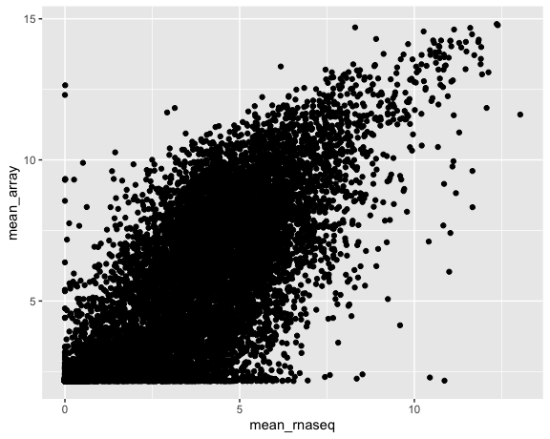

Slide 56
Colouring by correlation
all_summarized=inner_join(cor_sig,means,by="Gene") %>% filter(!is.na(estimate)) ggplot(all_summarized,aes(x=mean_rnaseq,y=mean_array,colour=estimate))+geom_point(alpha=0.2) + theme_cowplot()

Slide 57
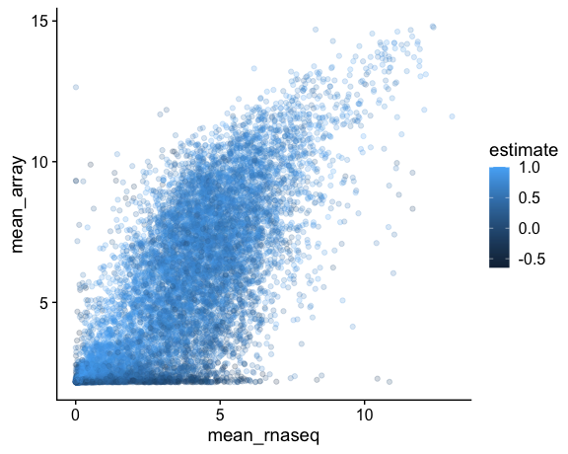

Slide 58
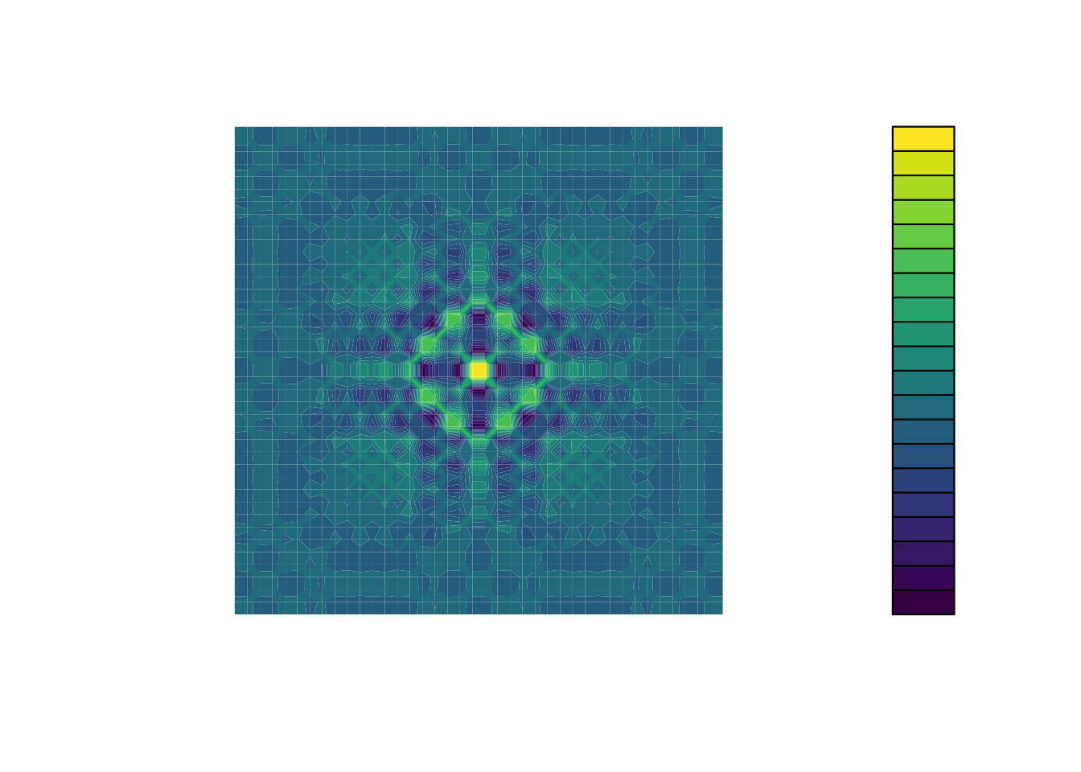
Continuous colorblind-friendly colours

Slide 59
ggplot(all_summarized,aes(x=mean_rnaseq,y=mean_array,colour=estimate))+geom_point(alpha=0.2) + theme_cowplot() + scale_colour_viridis_c()

Slide 60
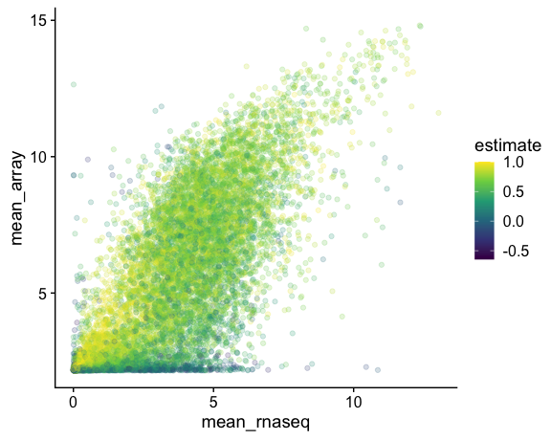

Slide 61
Significant points only
filter(all_summarized,p.value<0.05) %>% ggplot(aes(x=mean_rnaseq,y=mean_array,colour=estimate))+geom_point(alpha=0.2) + theme_cowplot()+ scale_colour_viridis_c()

Slide 62
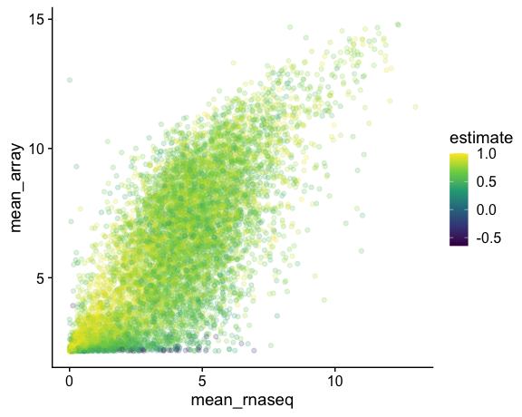

Slide 63
Restrict to moderate to high positive values
filter(all_summarized,p.value<0.05,estimate>0.5) %>% ggplot(aes(x=mean_rnaseq,y=mean_array,colour=estimate))+geom_point(alpha=0.2) + theme_cowplot()+ scale_colour_viridis_c()

Slide 64
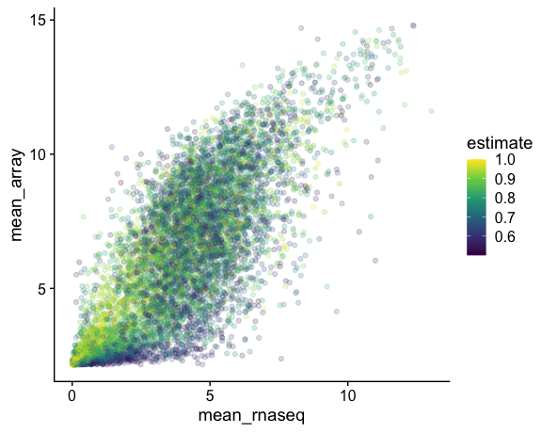

Slide 65
Interpretation
Some of the highest correlation coefficients among genes with low expression in both the array and RNA-seq
Are these outliers that we can justify removing?
ggplot(all_summarized,aes(x=mean_rnaseq)) + geom_histogram(colour = "white", boundary = 0) + labs(title="RNA-seq mean expression")

Slide 66
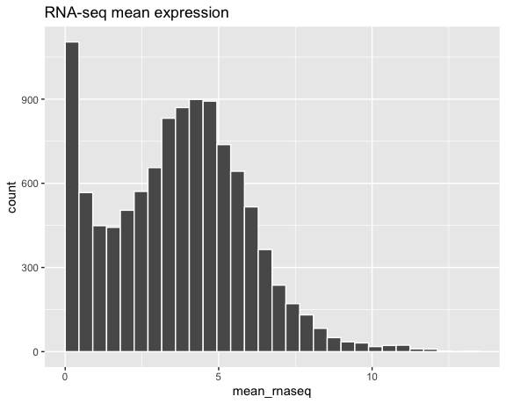

Slide 67
ggplot(all_summarized,aes(x=mean_array)) + geom_histogram(colour = "white", boundary = 0) + labs(title="array mean expression")

Slide 68
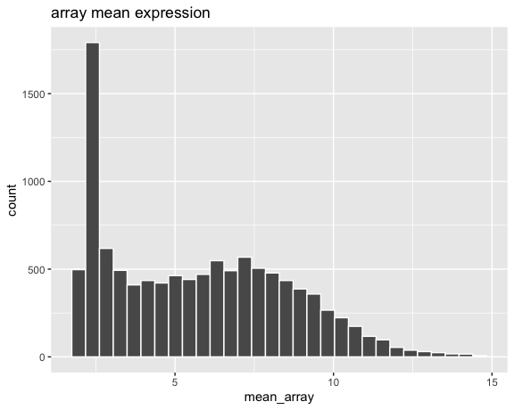

Slide 69
We should have removed outliers first!
kept_summarized = filter(all_summarized, p.value<0.05,estimate>0.5) %>% filter(mean_array>3.5,mean_rnaseq>2.5) #plot it again with the outliers removed ggplot(kept_summarized,aes(x=mean_rnaseq, y=mean_array, colour=estimate))+ geom_point(alpha=0.2) + theme_cowplot()+ scale_colour_viridis_c()

Slide 70
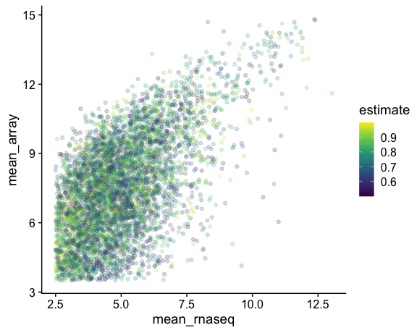

Slide 71
Sanity check a remaining gene
kept_summarized %>% arrange(mean_rnaseq) %>% select(Gene,estimate,p.value) %>% head()
## # A tibble: 6 x 3 ## Gene estimate p.value ## <chr> <dbl> <dbl> ## 1 PDP1 0.567 5.78e- 4 ## 2 KIAA1107 0.837 1.24e- 9 ## 3 SLC12A2 0.741 8.24e- 7 ## 4 ECEL1 0.968 3.98e-20 ## 5 TULP4 0.686 1.06e- 5 ## 6 PALMD 0.841 9.23e-10
filter(long_exp,Gene=="PDP1") %>% ggplot(aes(x=Expr.x,y=Expr.y)) + geom_point() + labs(title=paste("PDP1",": Best correlated gene"))

Slide 72
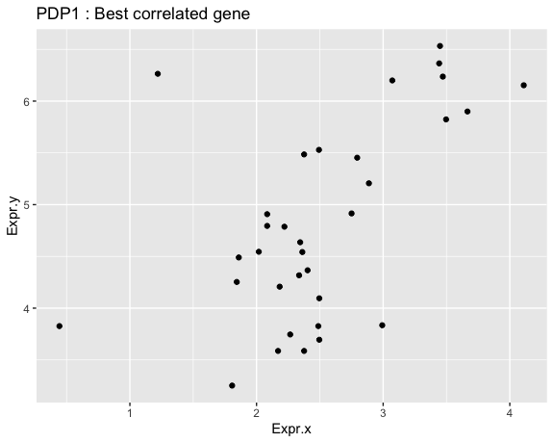

Slide 73
Recap
Extremely high/low correlation coefficients with significant P values may still be misleading
Values with very low variability or near the bottom of the dynamic range of either technique can’t be trusted
Removing outliers from our data leaves us with a data set with more meaningful correlations

Slide 74
Hypothesis testing
Thus far we’ve focused on tests of linear or monotonic relationships between continuous variables
Our hypothesis with these tests is that the two variables being compared are related
Array and RNA-seq are meant to give the same information so this is a sensible hypothesis
Another more common hypothesis is that variables have different averages (means) between two or more groups

Slide 75
Simple gene expression experiment
These data are from tumour samples from 33 patients (17 female, 16 male)
It’s reasonable to hypothesize that some genes (e.g. those on the sex chromosomes) will differ in their expression between M and F tumours

Slide 76
Single gene: ATRX
Arbitrarily picking a gene on chromosome X: DDX3X shows a possible difference
ddx3x_expr <- rnaseq_wide %>% select(Tumour, DDX3X) %>% left_join(metadata, by = "Tumour") ggplot(ddx3x_expr, aes(x = Sex, y = DDX3X)) + geom_boxplot(outlier.shape=NA) + geom_quasirandom()

Slide 77
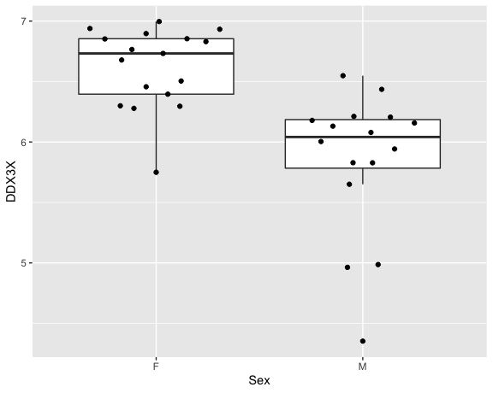

Slide 78
Wilcoxon test
wt_out = wilcox.test(ddx3x_expr$DDX3X ~ ddx3x_expr$Sex) tidy(wt_out)
## # A tibble: 1 x 4 ## statistic p.value method alternative ## <dbl> <dbl> <chr> <chr> ## 1 250 0.00000761 Wilcoxon rank sum exact test two.sided

Slide 79
Statistical test for differences
Wilcoxon rank sum test is a nonparametric test for different means
Sudent’s T test is a paramteric test for different means
Parametric tests make certain assumptions about the distribution whereas non-parametric tests don’t
This means that the result of a test (P value, coefficient) is not meaningful if those assumptions are not met
When in doubt: use a non-parametric test

